Slide 1
Beyond Traditional Methods: Radial Basis Functions for Stratigraphic Modelling Innovation in Complex Coal Deposits Norman Heckscher¹, Andrew Hughes², Barry Saunders¹ and Glynne Owen³ 1.QGESS Pty Ltd, Brisbane 2.Golding Contractors, Brisbane 3.JB Mining Services, Brisbane

Slide 2



Introduction
Unveiling the Subsurface: Pioneering Stratigraphic Modelling in the Bowen Basin
Collaborative Expertise: A Joint Effort by:
JB Mining Services
QGESS
Golding Contractors
Beyond Traditional Methods: Addressing the Challenges of Complex Coal Deposits
Innovation in Action: A Novel Approach to Accurate Volume Estimation

Slide 3
The Cycle of Geological Understanding
Geologists: Unlocking the Subsurface
Models: The Foundation for Optimised Mining
Reconciliation: The Key to Continuous Improvement
Efficient and Sustainable Resource Extraction
Beyond the Past: Evolving our Approach for the Future
Understanding Today, Shaping Tomorrow:
The Path to Sustainable Mining in the Sydney Basin

Slide 4
The Mine Geologist's Modelling Cycle
1. Publish Model
5. Refine Model
2. Mine
4. Reconcile
3. Measure

Slide 5
Independent Surfaces

Slide 6
Independent Surfaces
Extra infill drilling == $$$ costs

Slide 7
Independent Surfaces
Poor forecasts
lost marketing/blending opportunity cost

Slide 8
Stacking Surfaces
Control points & strings location determined using dip meters or in-situ measurements
Reference Surface
Roof or Floor
Control points & strings “pull” the surface into place.

Slide 9
Stacking Surfaces
To determine seam roof/floor add/subtract thickness from reference surface
Removes subjectivity & maintenance of control points.
Deterministic solution with problems.

Slide 10
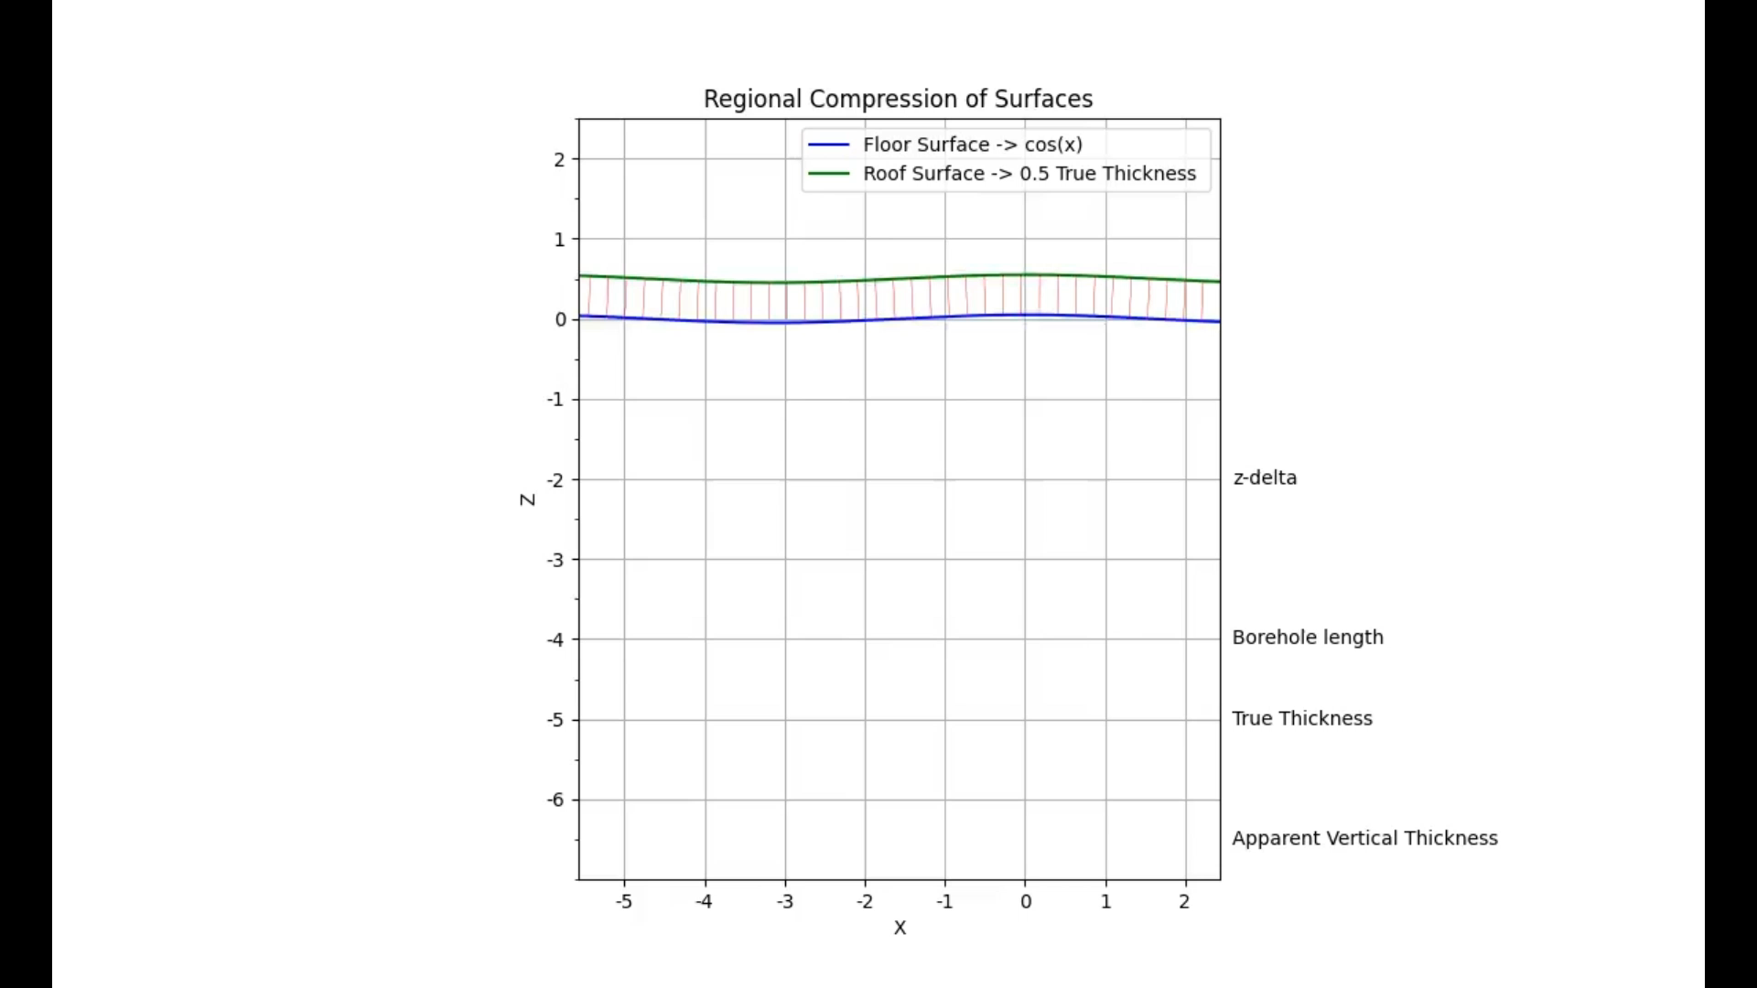
Animation

Slide 11
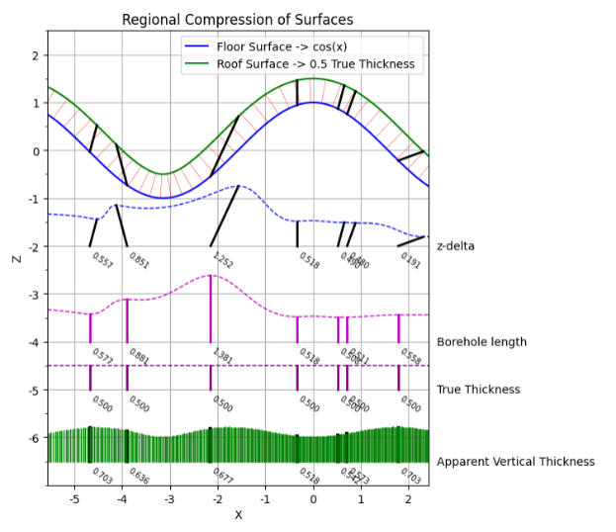
Animation

Slide 12
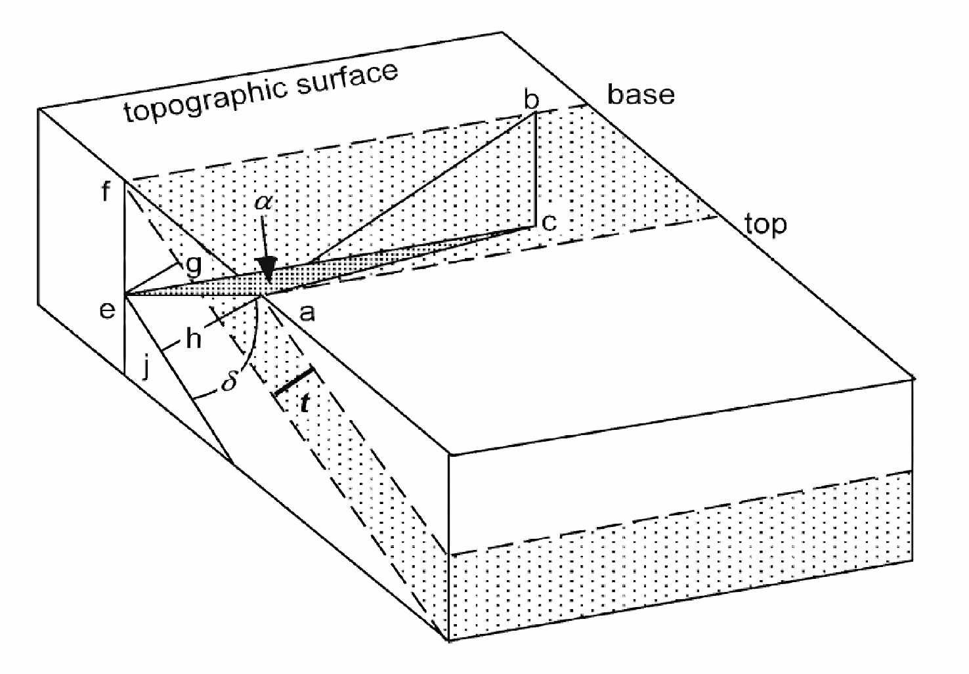
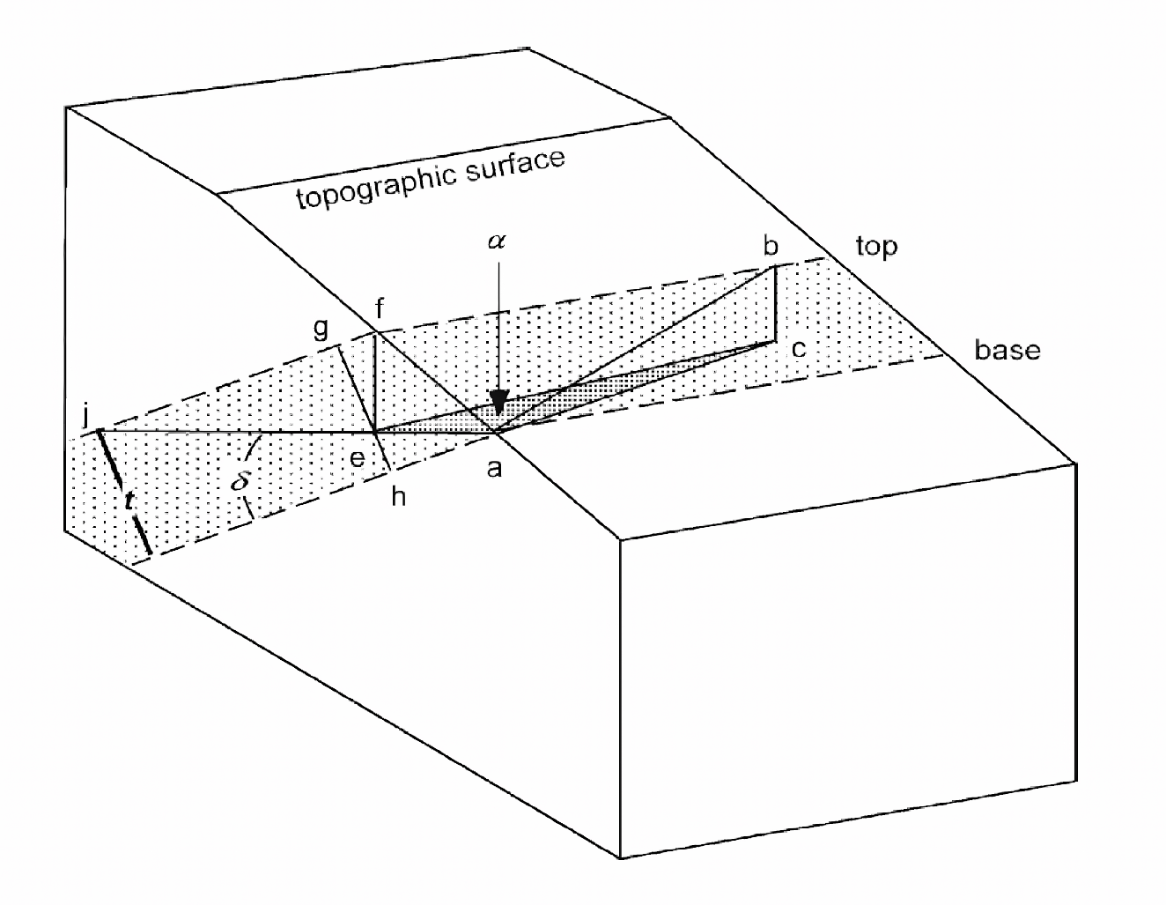
Denison 1968
t = |h cos α sin δ − v cos δ|
t = h cos α sin δ+ v cos δ
Long Live Pythagoras.

Slide 13
Animation

Slide 14
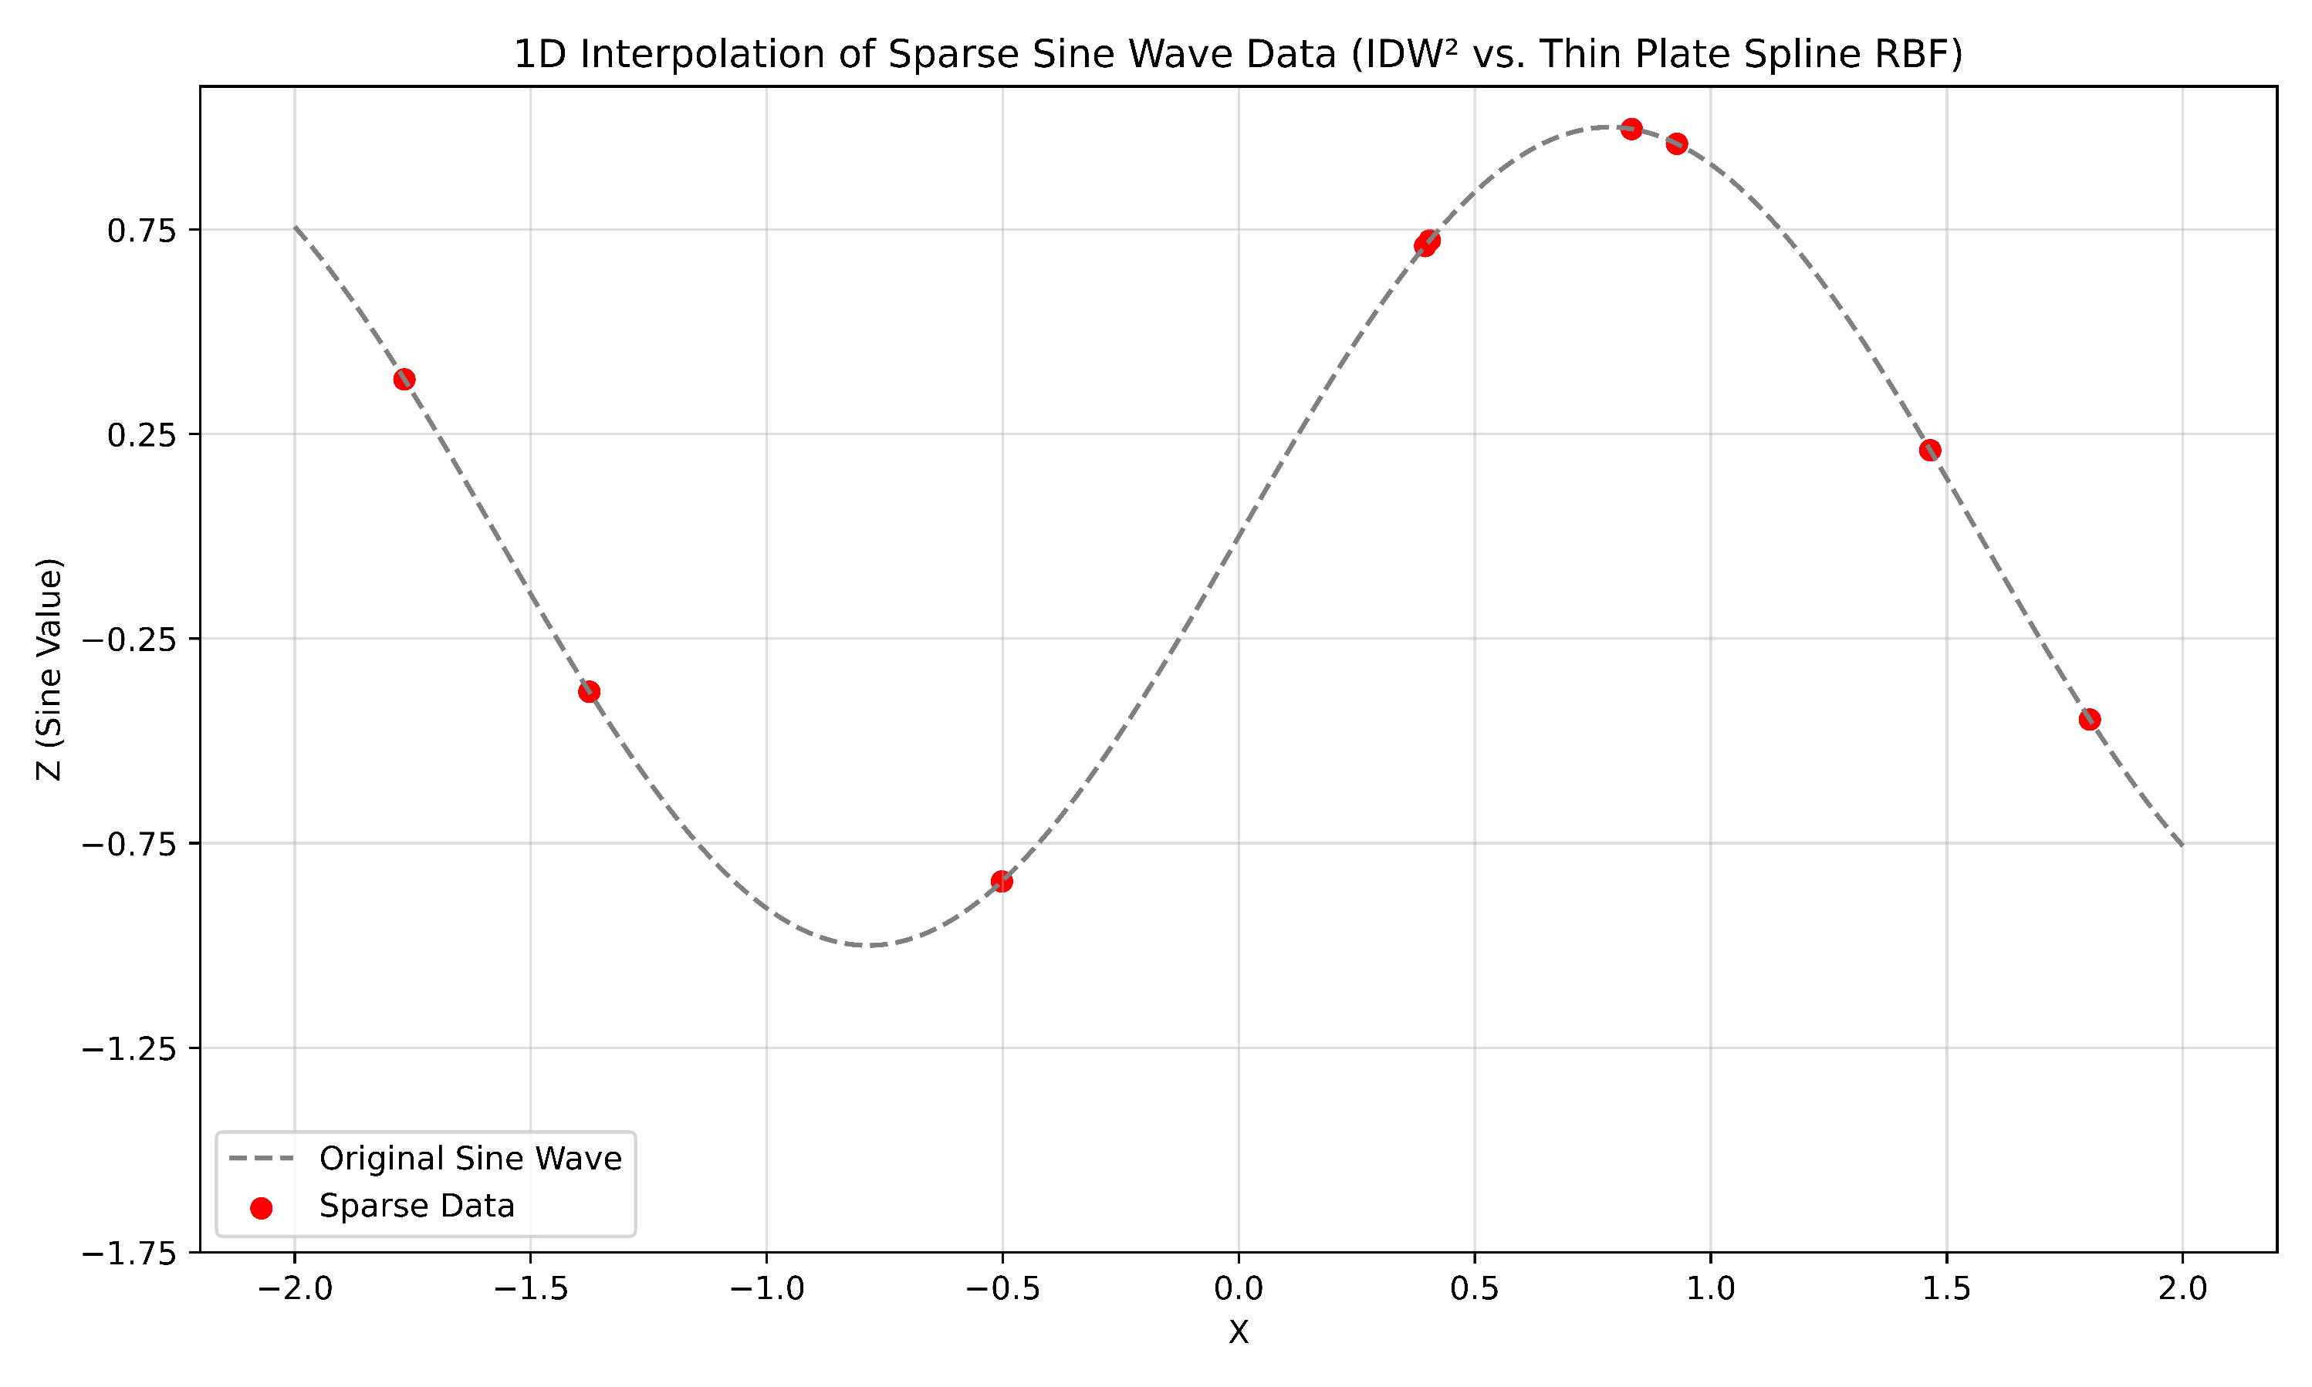
IDW vs RBF (synthetic)

Slide 15
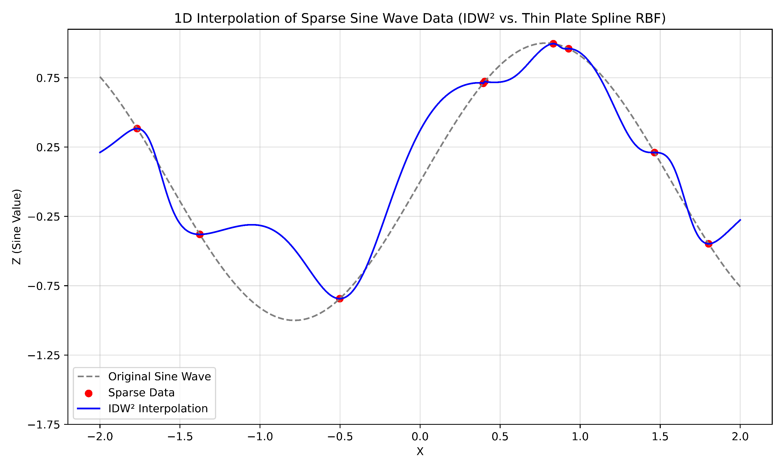
IDW vs RBF (synthetic)

Slide 16
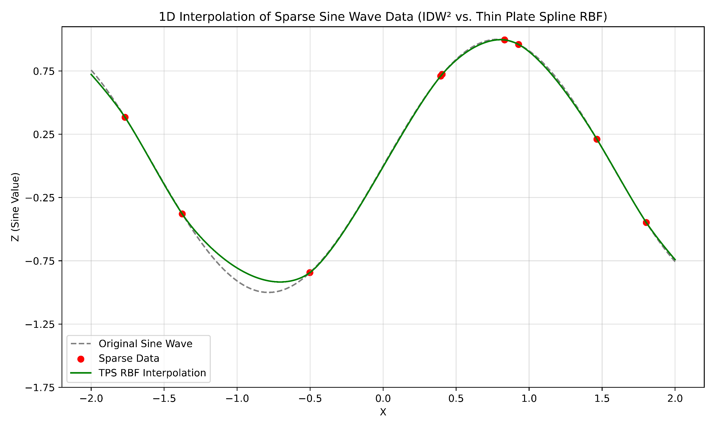
IDW vs RBF (synthetic)

Slide 17
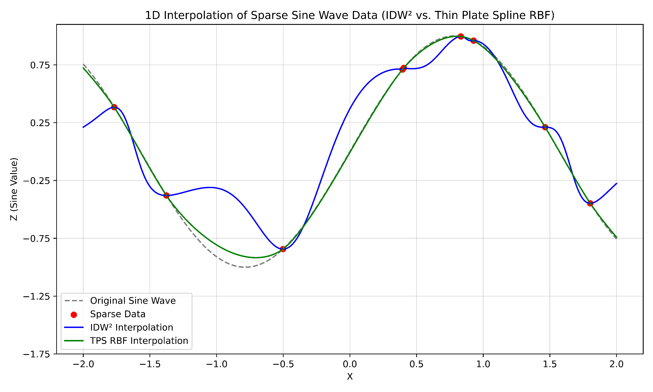
IDW vs RBF (synthetic)

Slide 18
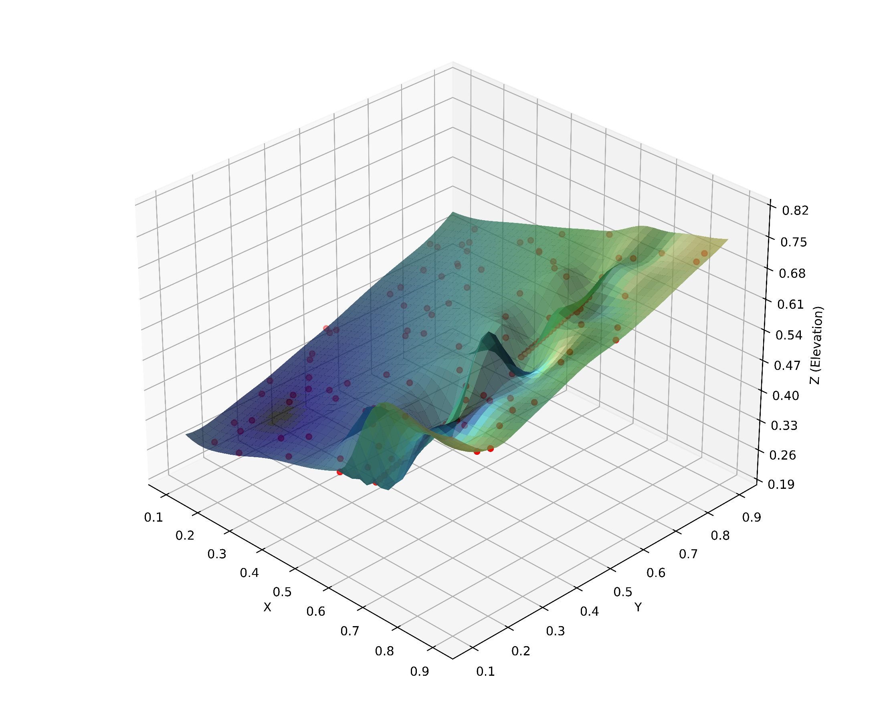
IDW vs RBF (synthetic)

Slide 19
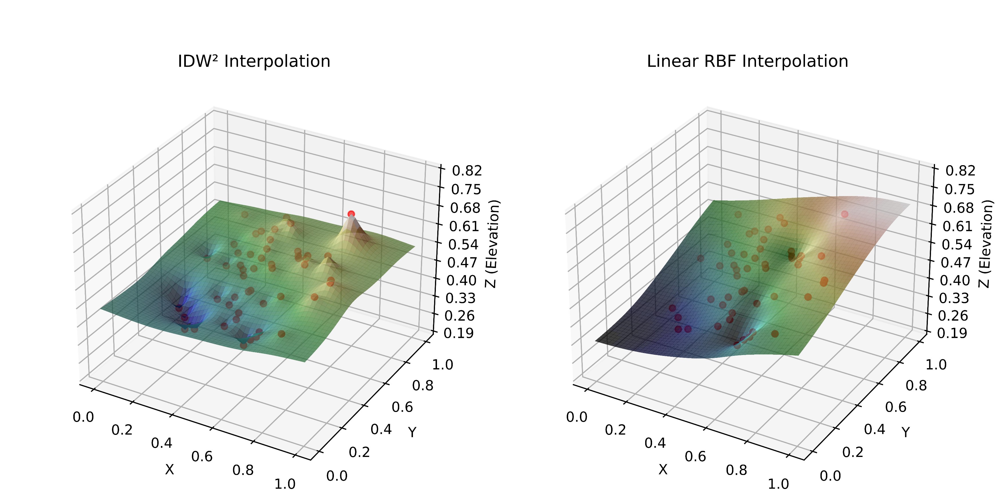
IDW vs RBF (synthetic)

Slide 20
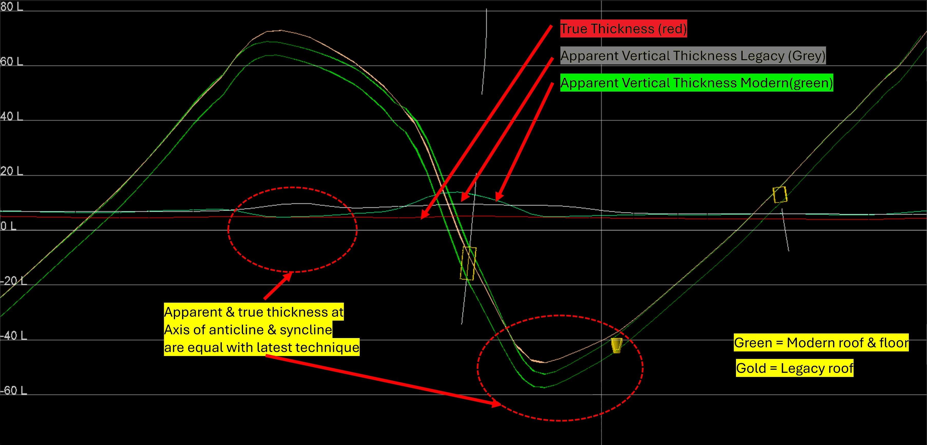
Working Examples

Slide 21
Theory aligns with practice

Slide 22
Five Easy Steps
Create structural reference surface.
Determine true thickness at empirically observed roof/floor survey point pairs (exploration & insitu survey pickups & geophysically logged Drill and Blast holes).
Model a smooth true thickness grid surface across the deposit incorporating these scattered points using a Radial Basis Function.
Convert every grid point in the true thickness surface to an apparent vertical thickness.
Subtract the apparent vertical thickness surface from the structural roof reference surface to create a floor surface.

Slide 23
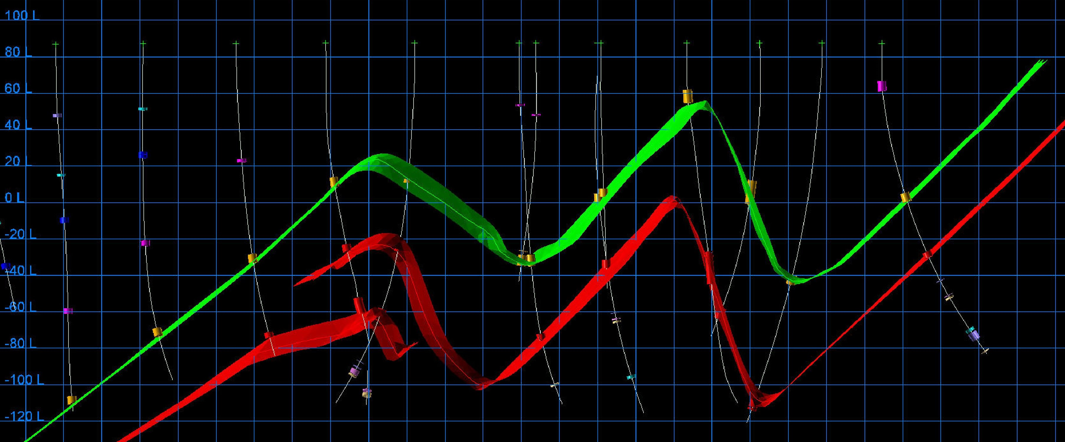
Working Examples

Slide 24
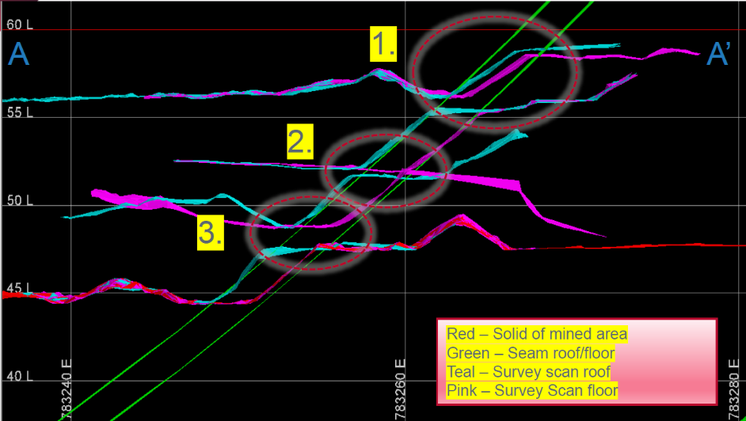
Working Examples

Slide 25
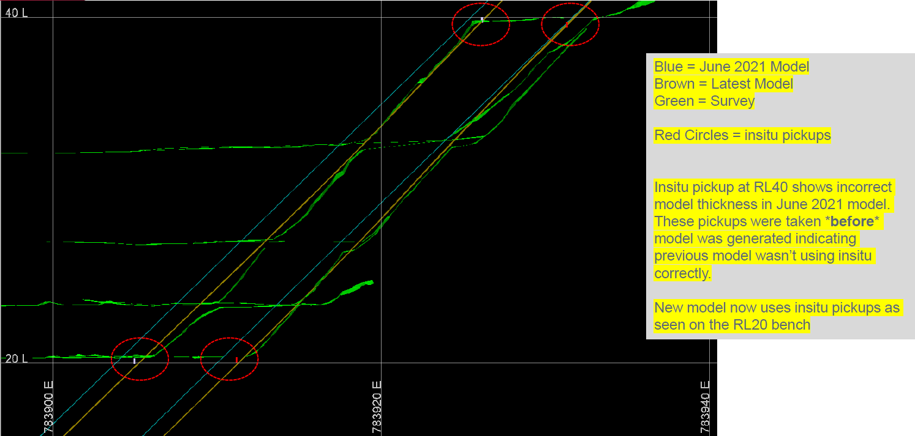
Working Examples

Slide 26
Working Examples – Benefits - Summary
Accurate models = Informed decisions, optimized resource extraction
Inaccurate models = Costly errors, missed targets, inefficiencies
Traditional methods struggle with complex geology
RBFs + trigonometry = Enhanced accuracy & precision
Proven success, even in challenging settings

Slide 27

Working Examples – Thank you!
Working code is available on github
Rather messy, however, it’s waiting for your pull request
https://github.com/normanheckscher
norman@qgess.com.au
Thank you.

Slide 28
IDW vs RBF (synthetic)

